Slide 1
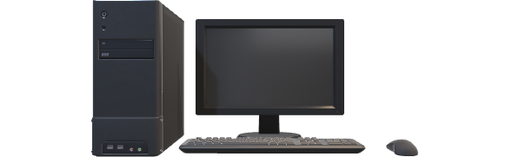

COMPUTER LABORATORY MANAGEMENT SYSTEM
By
Aniruddha Lagad
Sachitanand Ghule

Slide 2
Contents
Introduction
Screenshots
Future enhancement
Limitations
Conclusion

Slide 3
Introduction In the realm of educational institutions, the effective management of computer laboratories plays a pivotal role in facilitating seamless learning experiences for students and optimizing resources for educators. The Computer Laboratory Management System (CLMS) emerges as a sophisticated solution designed to streamline the operational aspects of computer laboratories within academic settings. The Computer Laboratory Management System (CLMS) is a sophisticated solution tailored for educational institutions to streamline the management of computer laboratories. Offering a range of functionalities, CLMS enables users to check practical schedules, lab availability, practical exam schedules, and track lab assignments. Additionally, it provides real-time information on lab occupancy, facilitates the download of lab materials, and ensures efficient utilization of laboratory resources. In essence, CLMS enhances the learning experience by fostering efficiency, transparency, and collaboration within academic environments.

Slide 4
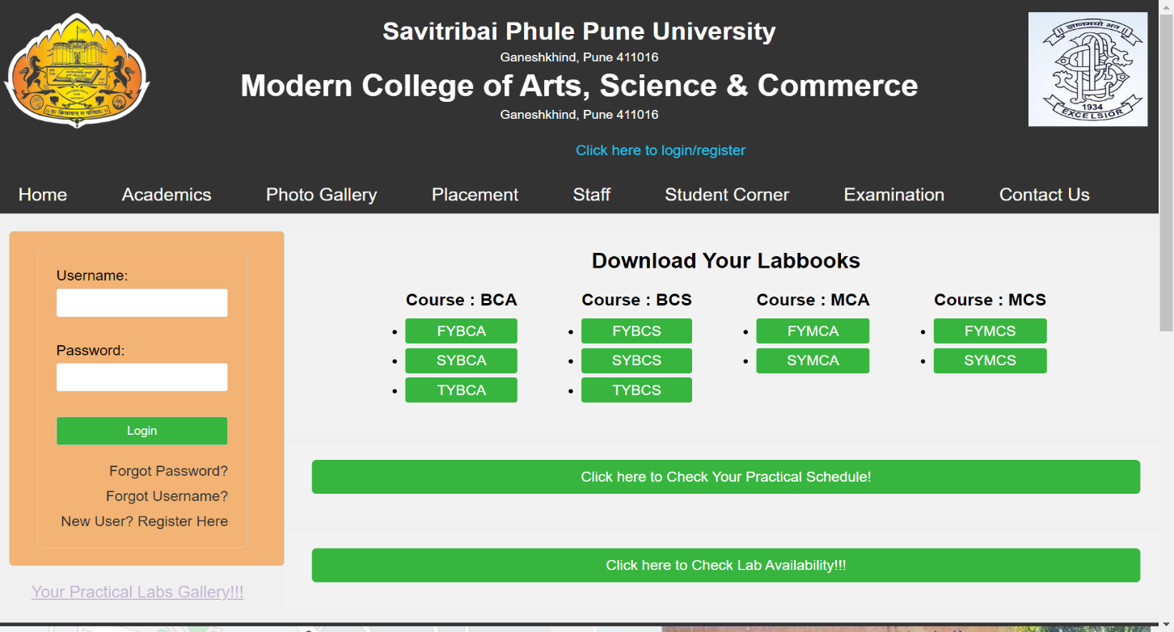
Screenshots HOMEPAGE

Slide 5
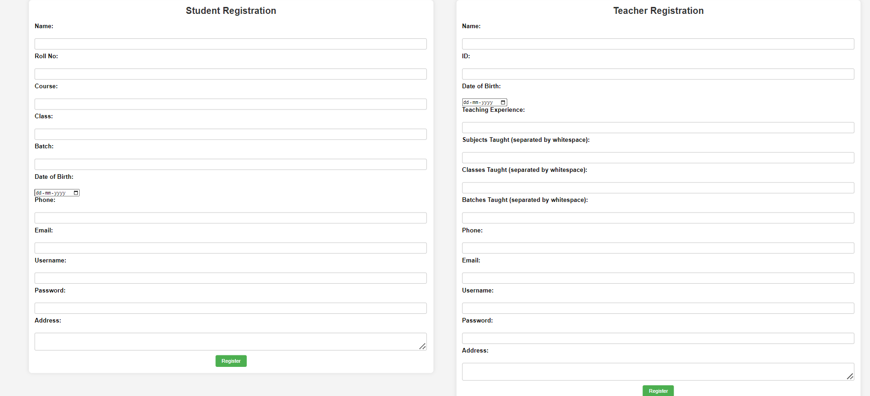
Registration Page

Slide 6
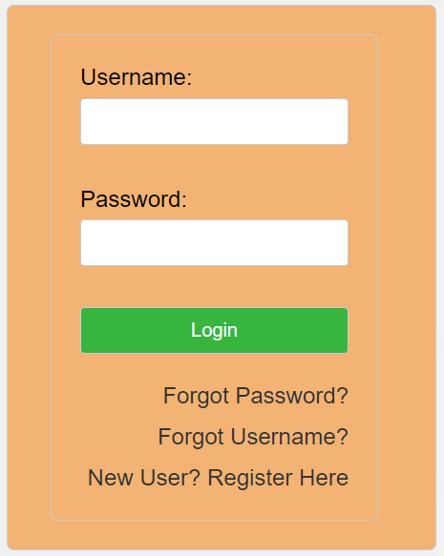
Login Page

Slide 7
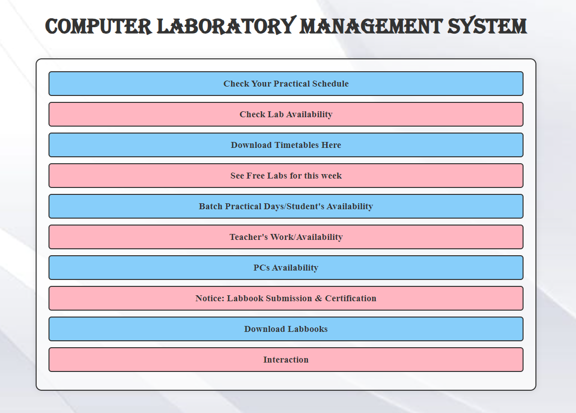
HOMEPAGE

Slide 8
Future Enhancement
Will send the forgot password & forgot username on the users Email & SMS to avoid insecurity to user account.
Also we will provide OTP based authentication service for the security purpose.
Will provide more modularity to the project. So that it can be implemented by any institute/college/university with flexibility & robustness.
Will take more precautions while registration to avoid incomplete/inaccurate data.
Will convert this web application into android application with further more improvements.

Slide 9
Limitations
Lack of Customization: If the system lacks flexibility or customization options, it may not meet the diverse needs of different educational institutions or fail to adapt to changing requirements over time.
Incomplete or Inaccurate Data: Inaccurate or incomplete data entry by users can undermine the system's effectiveness and reliability, leading to errors or inconsistencies in scheduling, assignments, or other functionalities.
Currently the system doesn’t provide high security as it doesn’t have OTP based authentication.

Slide 10
Conclusion
In conclusion, the Computer Laboratory Management System (CLMS) project represents a significant step forward in optimizing the management and utilization of resources within educational institutions. Through the development and implementation of this system, several key objectives have been achieved, including facilitating efficient scheduling of practical sessions, lab availability etc.
The CLMS project offers a user-friendly interface that streamlines administrative tasks for both students and teachers, enhancing overall productivity and organization. By centralizing information related to laboratory schedules, assignments, and equipment availability, the system promotes transparency and accountability, ultimately contributing to a more effective learning environment.
While the CLMS project has made significant strides in addressing the challenges associated with laboratory management, there is room for further refinement and enhancement. Future iterations of the system could focus on incorporating advanced analytics capabilities, improving scalability, and enhancing security measures to ensure data integrity and confidentiality.
Overall, the CLMS project serves as a valuable tool for educational institutions seeking to optimize resource allocation, improve operational efficiency, and enhance the overall learning experience for students and educators alike. With continued support and investment, the CLMS project has the potential to evolve into a cornerstone of laboratory management in educational settings.

Slide 11
Thank You!!!
Aniruddha Lagad
aniruddhalagad57@gmail.com
Sachitanand Ghule
sachinrghule25@gmail.com

